Slide 1
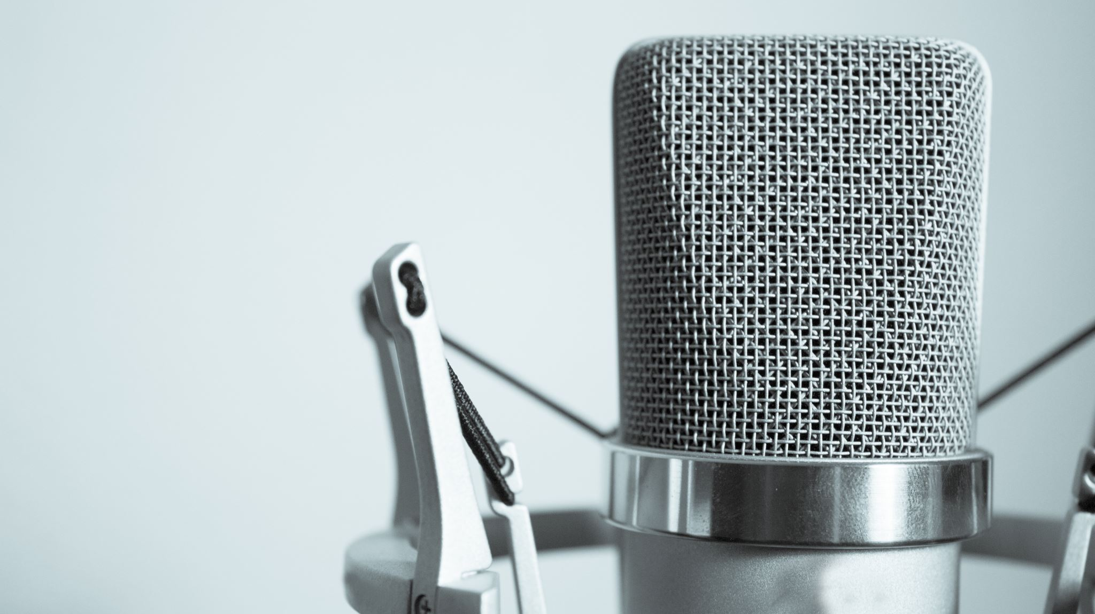
PERSONAL VOICE ASSISTANT
G.SAITEJA -2010030055
MD.ADNAN-2010030236
G.SAMANTH-2010030272
K.TRIBHUVAN-2010030402

Slide 2
Introduction
A voice assistant is a digital assistant that uses voice recognition, language processing algorithms, and voice synthesis to listen to specific voice commands and return relevant information or perform specific functions as requested by the user.
Virtual Assistants are software programs that help you ease your day to day tasks, such as showing weather report, creating reminders, making shopping lists etc. They can take commands via text (online chat bots) or by voice. Voice based intelligent assistants need an invoking word or wake word to activate the listener, followed by the command.
This system is designed to be used efficiently on desktops. Personal assistant software improves user productivity by managing routine tasks of the user and providing information from online sources to the user.

Slide 3
PROBLEM STATEMENT
We already have multiple virtual assistants. But we hardly use it. There are number people who have issues in voice recognition. These systems can understand English phrases but they fail to recognize in our accent. Our way of pronunciation is way distinct from theirs. Also, they are easy to use on mobile devices than desktop systems. There is need of a virtual assistant that can understand in Indian accent and work on desktop system.

Slide 4
METHODOLOGY
The overall system design consists of following phases:
(a) Data collection in the form of speech.
(b) Voice analysis and conversion to text
(c) Data storage and processing
(d) Generating speech from the processed text output

Slide 5
techniques
conventional Speech Enhancement (SE) technique:
It uses the parameters required for noise suppression are derived based on statistical models and are estimated from the noisy observations. The aim of a conventional speech enhancement system is to suppress the noise in a noisy speech signal. For robust speech recognition, such a system is used as a preprocessor to a speech recognizer Since it produces a clean speech signal, no changes in the recognition system .

Slide 6

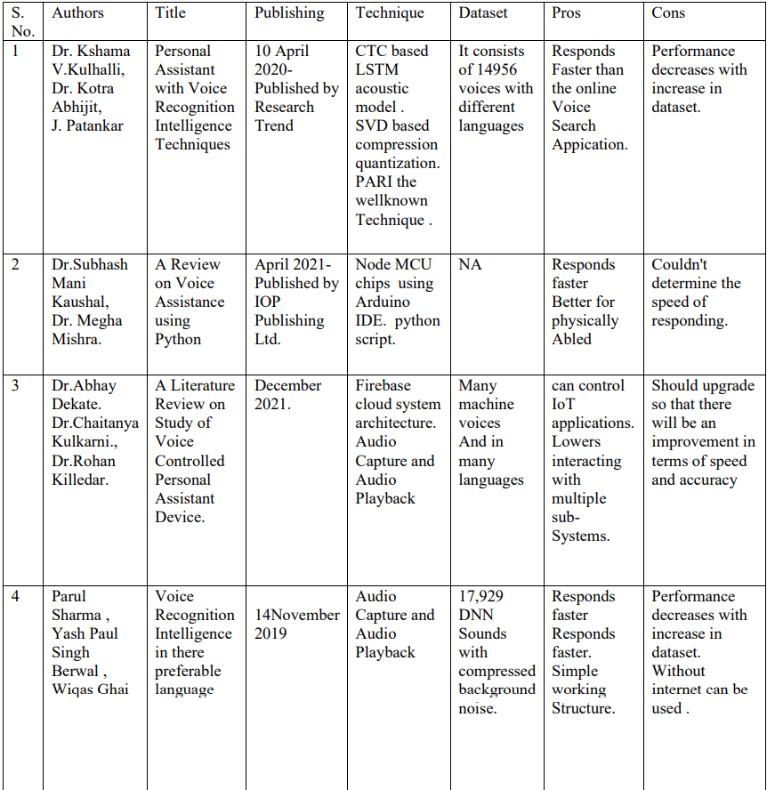
Literature survey

Slide 7
Proposed System Feature
It always keeps listing for its name and wakes up to response upon calling with the assigned functionality.
It keeps learning the sequence of questions asked to it related to its context which it remembers for the future. So when the same context is mentioned, it starts a conversation with you asking relevant questions.
Searching Internet based on user’s voice input and giving back the reply through a voice with further interactive questions by machine.
Other features such as playing music, saying time and date, setting an alarm. Setting reminders, spell-correct, etc.. can be performed by an input from user’s voice
.

Slide 8
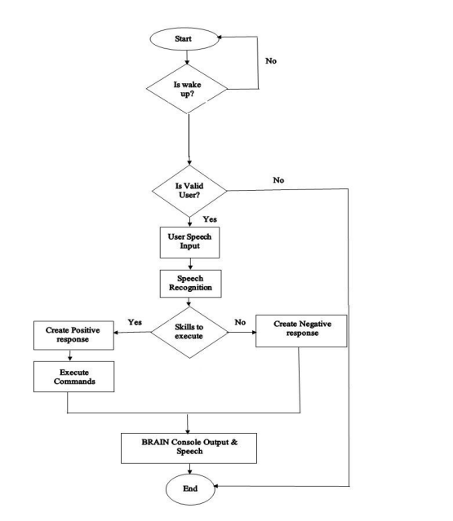
Flow chart
.
.

Slide 9
Audio Pre-Processing
Voice commands are stored in .wav files, and if we can get the spectrogram of an audio file, we can feed it into a CNN to classify it. Fortunately, the Python library librosa makes things a lot easier for us, so we can easily generate spectrograms.

Slide 10
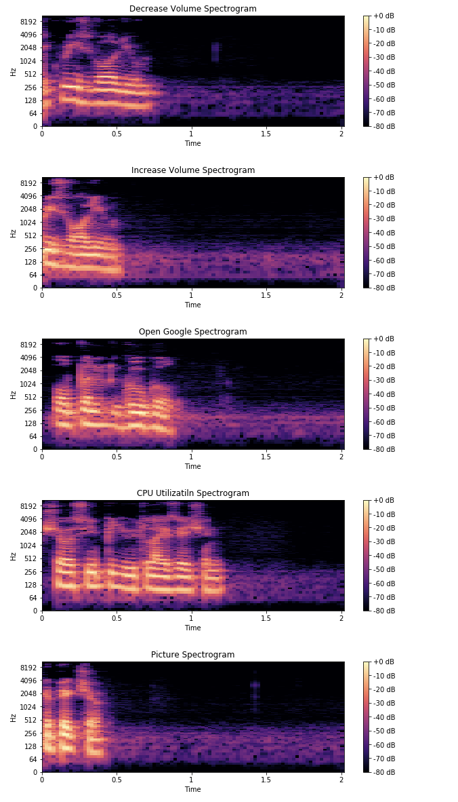
Spectrogram Images

Slide 11
FUTURE SCOPE
Using this system as a framework, the system can be expanded to features security. Security is important these days so it can be combined with this system to give more advanced security features. In this, the voice authentication technology can be implemented for more security. More advancement are possible like operating on various tones or accents from different regions that mean it should be able to perform operations on various voice tones and accents.. Further modifications are possible like learning the answer of questions that are not known by the voice assistant and replying whenever next time the same question is put up by the user.

Slide 12
conclusion
Voice Controlled Personal Assistant System will utilize natural language processing and artificial intelligence techniques to create a smart assistant that can perform IoT applications and even solve user queries by using web searches...Using it can reduce human effort required for interaction with many other subsystems, which would otherwise need to be performed manually.

Slide 13

References
V. G.Bohouta, "Comparing speech recognition systems," International journal, 2017.
D.Yulli, "Using voice assistant skills," International journal, 2019.
J. F. Hill, "Real conversations with artificial intelligence," International journal, 2015.
Algou+, "Voice assistant," World journal of education, 2016.
"Dillon T," International journal, 2018.
H. j, "Extracting chatbot knowledge from assistant," International journal, 2007

Slide 14
THANK YOU
MENTOR: Dr. Arpita Gupta

